Slide 1
PI Report Refresh Information Session
Accounting & Fiscal Services and OIT

Slide 2
Agenda
PI Report Background
Why Refresh
Technical Summary
UI Changes
Discussion Issues

Slide 3


PI Report Background
Developed in 2002 for FS and PPS
  Refactored for KFS in 2014
  Refactored for UCPath in 2019
We have over 150 users a month
Supported functionality
  KFS interface for GL balances and PO commitments
  UCPath interface for salary commitment and benefit projection
  Projection Reports

Slide 4


Why Refresh the PI Report?
The PI Report is a decades old system, and the technology behind it was obsolete and difficult to maintain.
OIT has rebuilt and refreshed the system with no loss in functionality so the campus can continue to use this system moving forward.

Slide 5

Technical Changes
Framework change
  The company/vendor that supported the technology has been gone for nearly 20 years
  Rebuild to a different framework/technology so we can better troubleshoot bugs, maintain, limited expertise, and support the PI Report
  You may notice little improvements in speed & responsiveness
  New Navigation Improvements

Slide 6
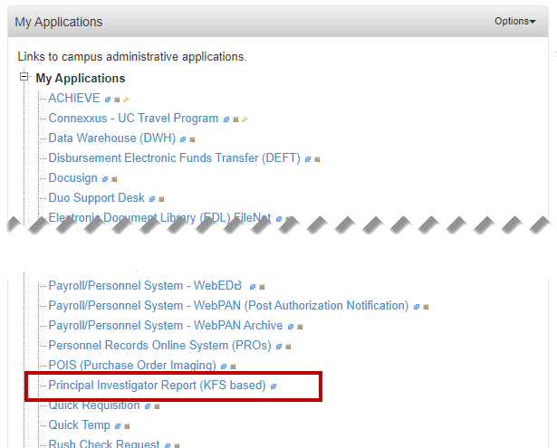
New URL! Same Place
Please Update any bookmarks
https://systems.oit.uci.edu/pireport/main.do
Access the PI Report under My Applications in ZotPortal

Slide 7
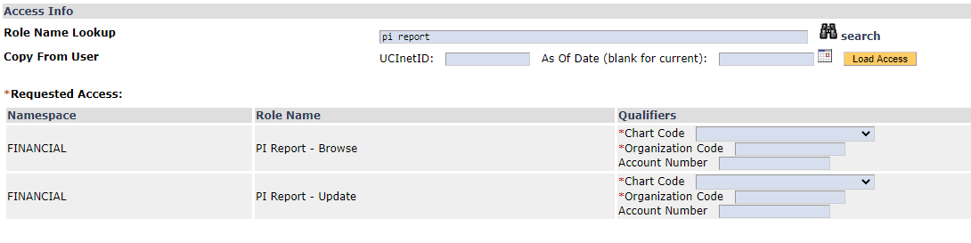
Access is the Same
Same KSAMS Roles
  PI Report – Browse
  PI Report – Update

Slide 8
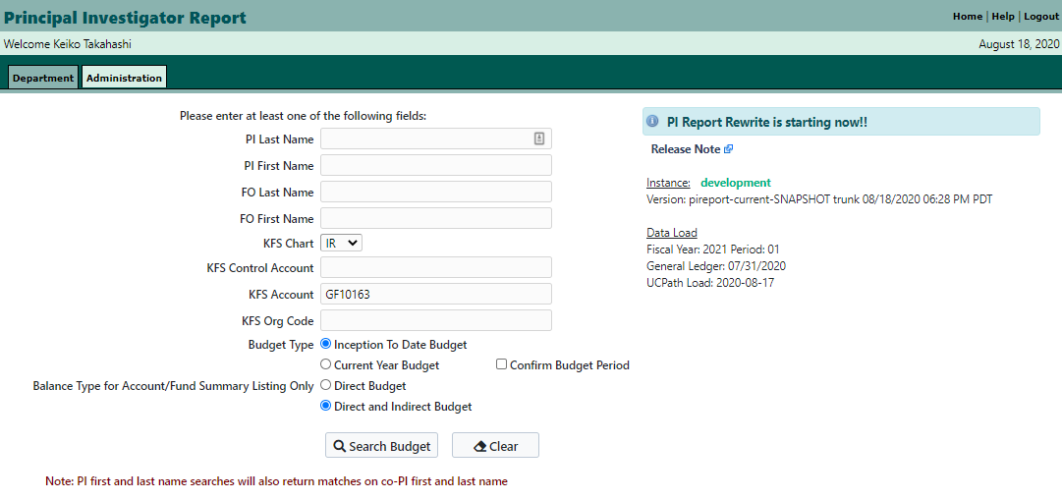
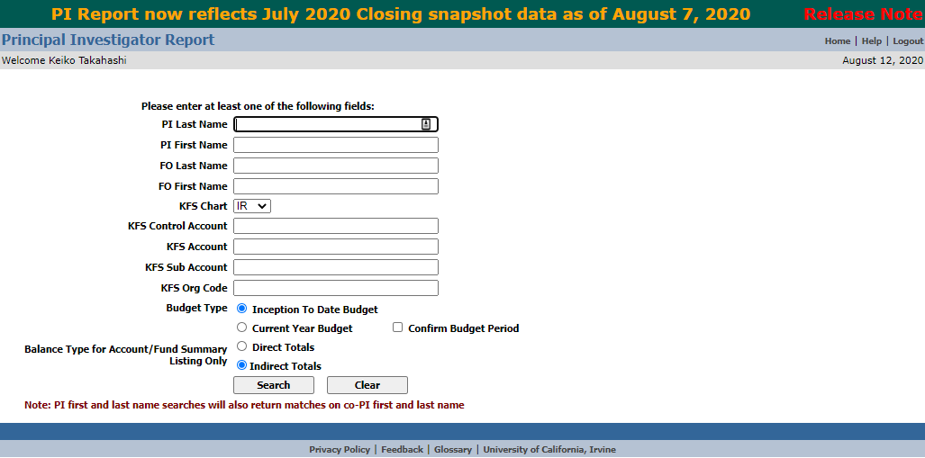
Main Page
Notes:
Tabbed interface
Breadcrumb
System information
Clarified the Direct Budget label to Direct and Indirect Budget
addition of system updates, FY and period, Message of the Day

Slide 9
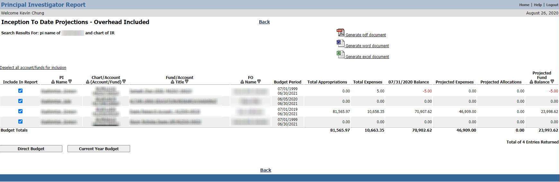
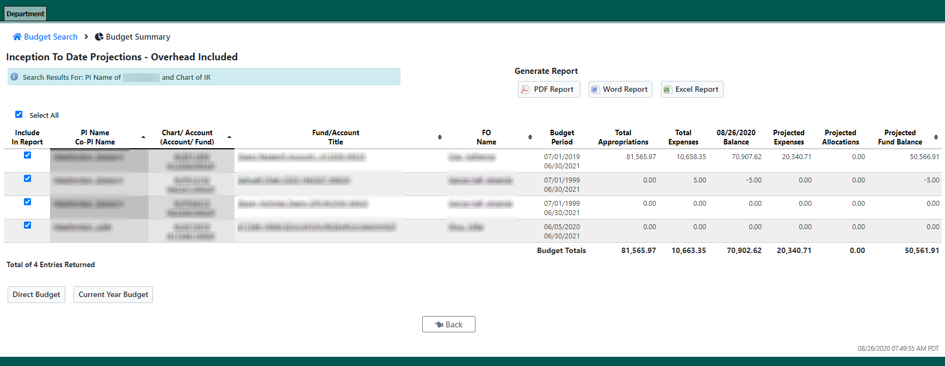
Budget Summary
Notes:
Select All checkbox
Fixed the Direct Budget and Direct/Indirect Budget figures - it was not working before

Slide 10
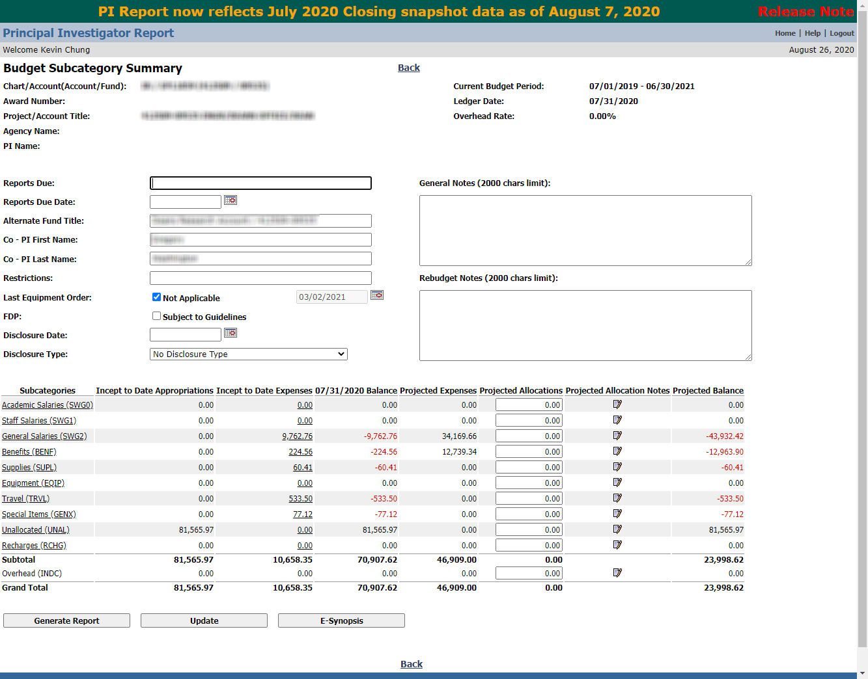
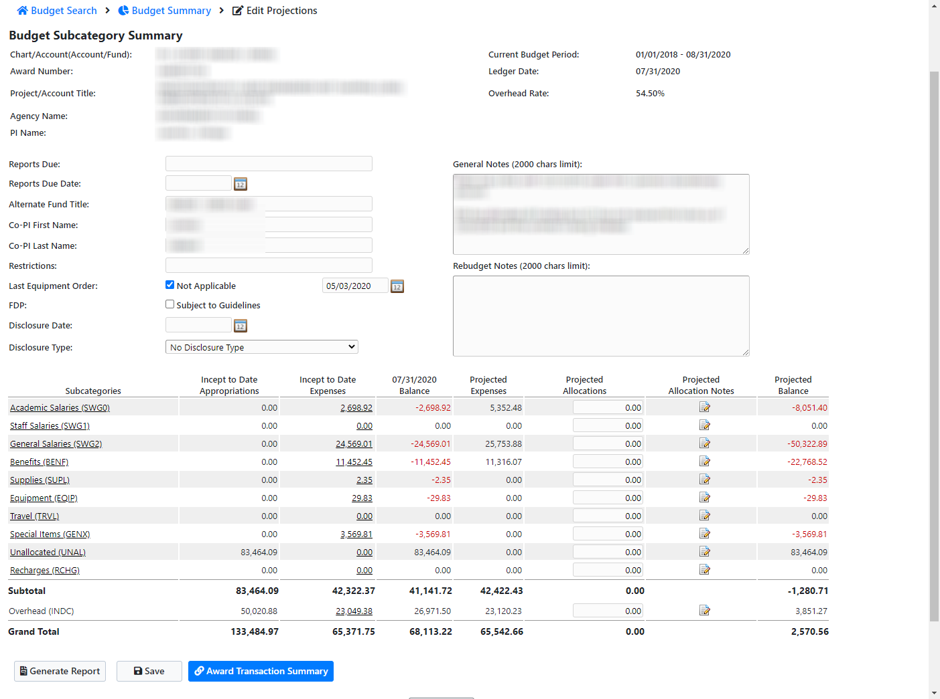
Budget Subcategory Summary
Notes:
Notes icon with a tooltip
Award Synopsis goes to KR report

Slide 11
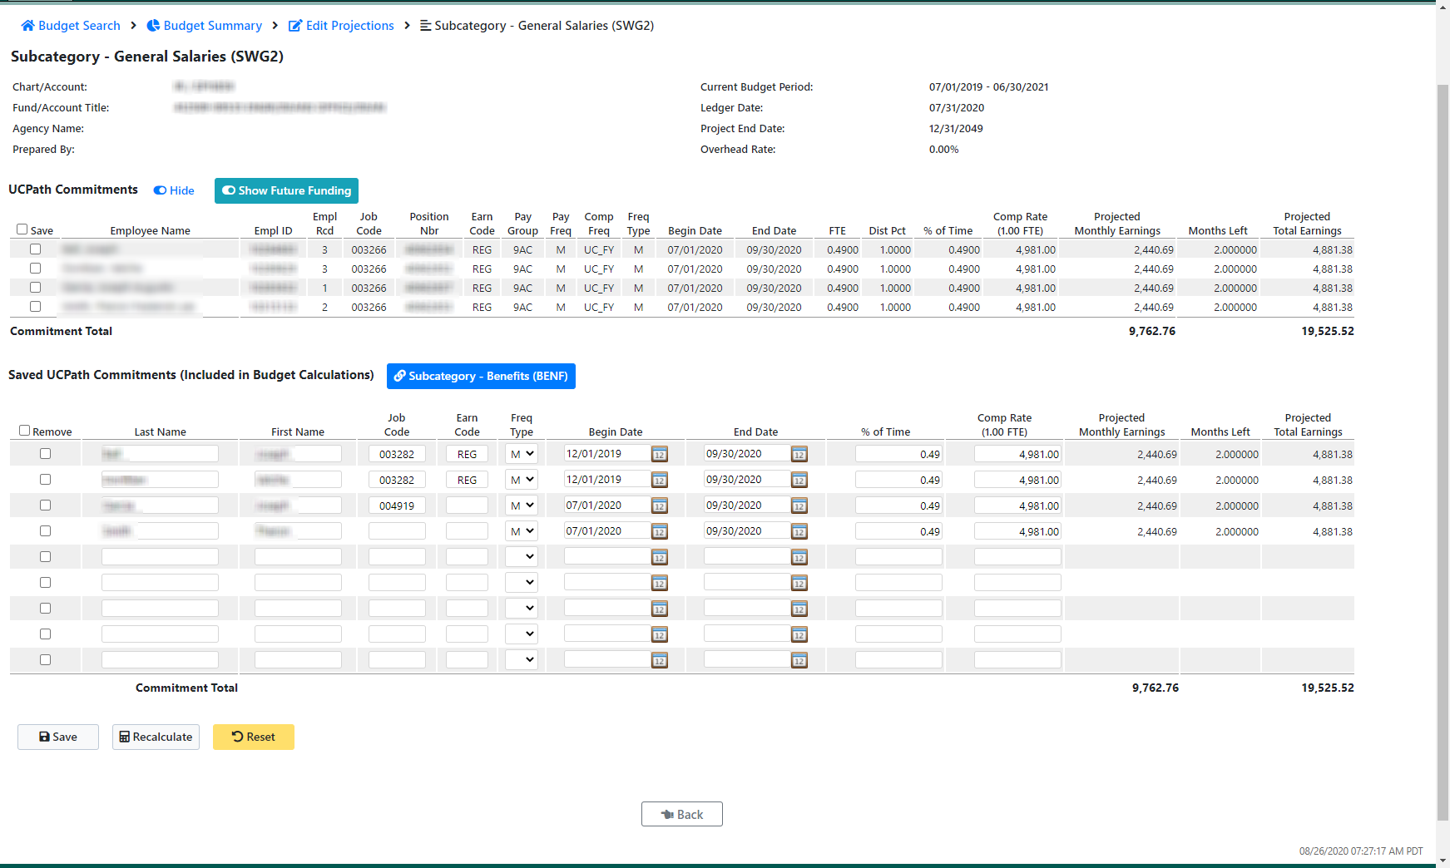
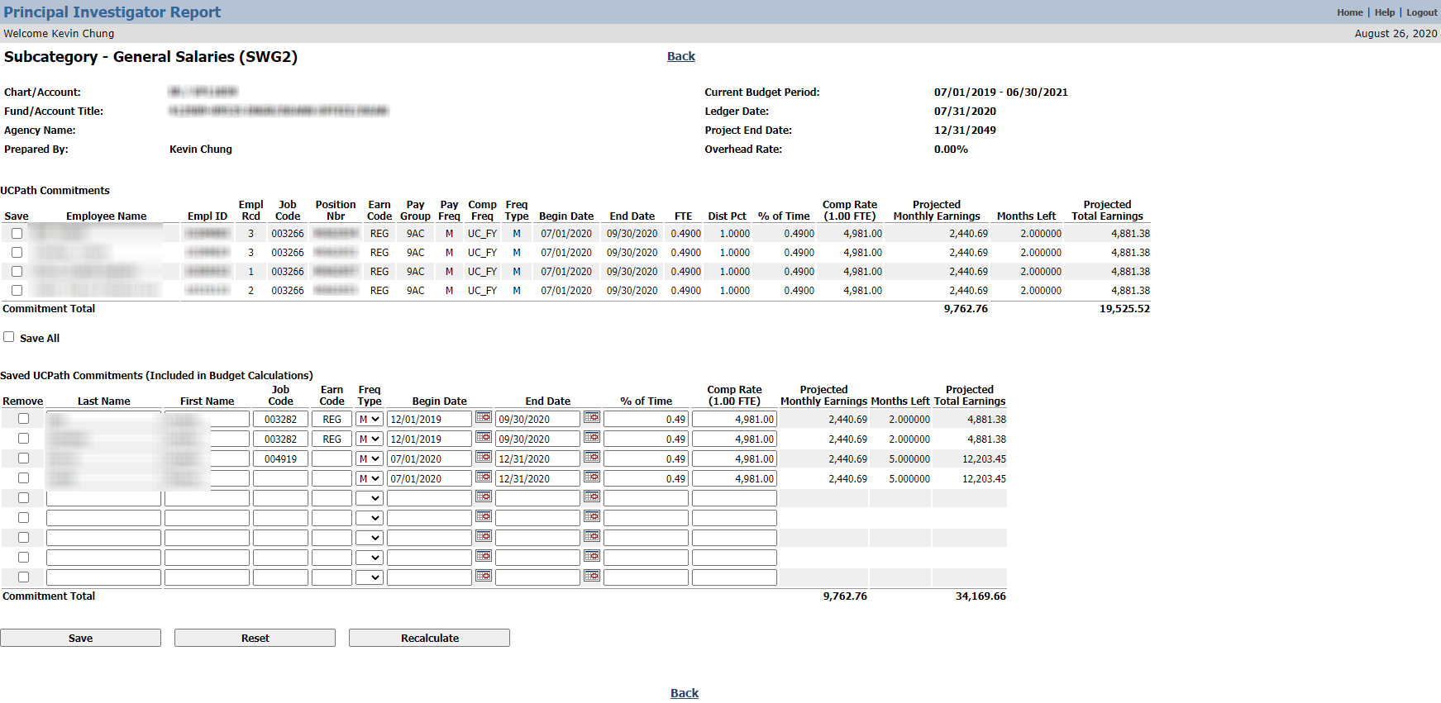
Subcategory Salaries
Notes:
Hide and show UCPath Commitment
Hide and show future funding
Easy navigation to Benefit

Slide 12
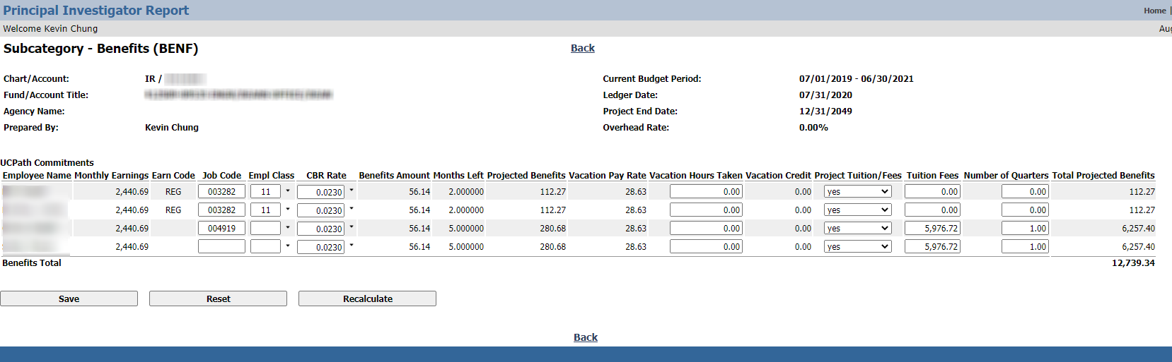
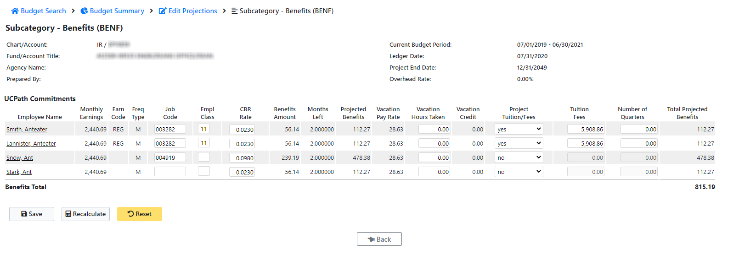
Subcategory Benefits
Notes:
Easy link back to salary page
Added Frequency Type

Slide 13
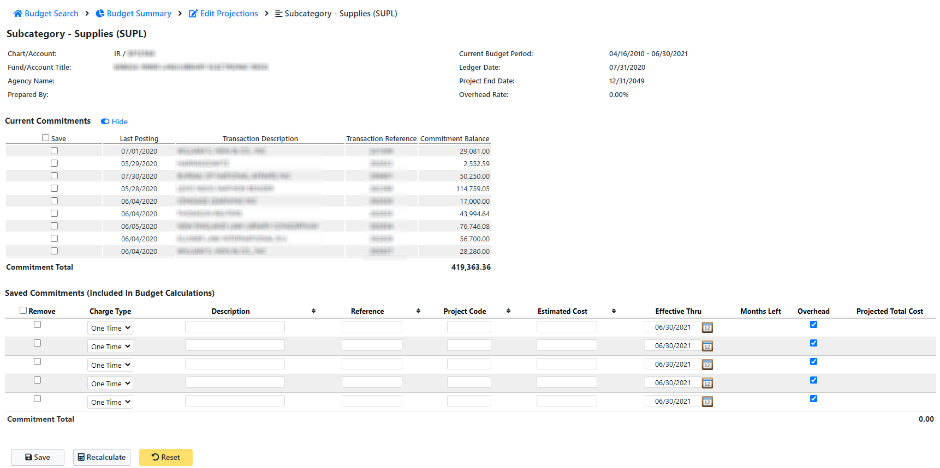
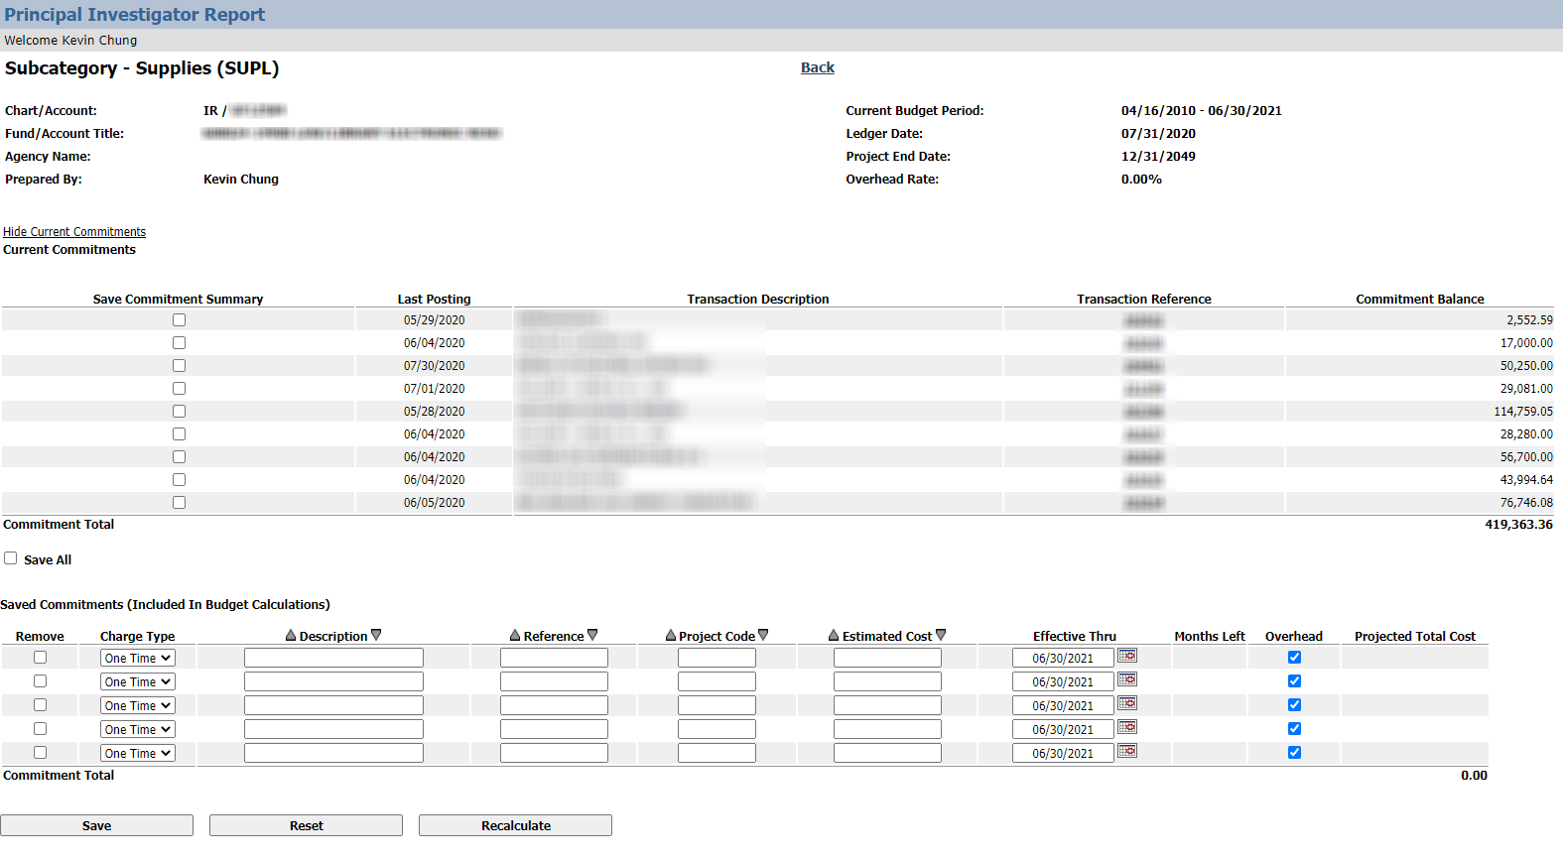
Subcategory Non-Payroll
Notes:
Removed transaction reference link - commitment history was an old concept with FS
Added remove checkbox to select all saved commitments and to be able to remove all commitments

Slide 14
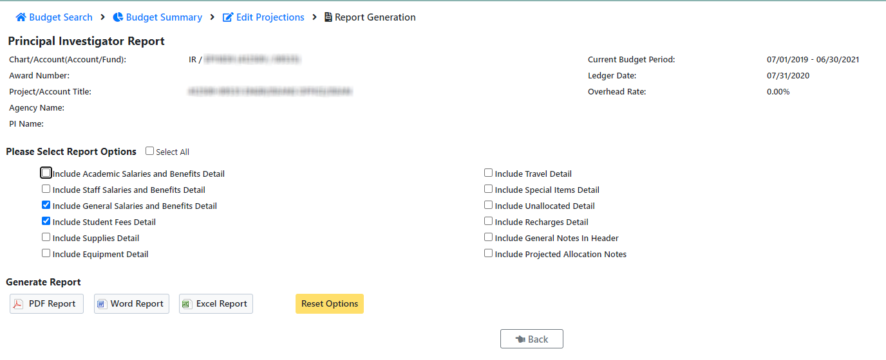
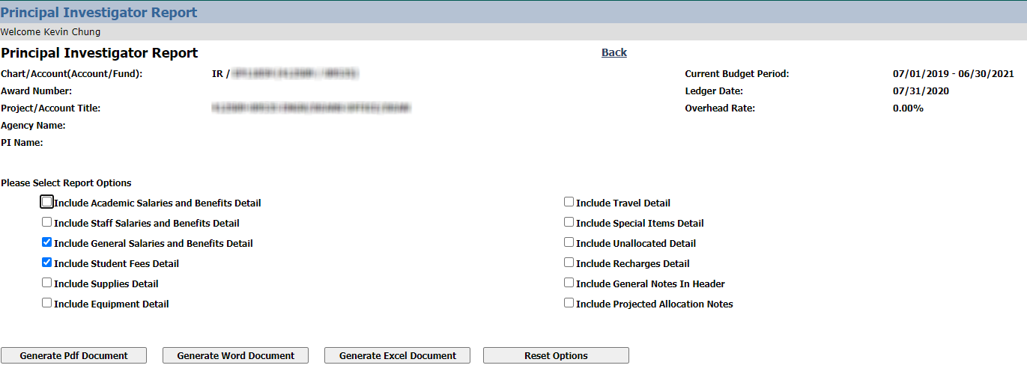
Generate Report
Notes:
Select All button is now available

Slide 15



Other UI Improvements
Consistent look and feel: select all buttons on all pages, button names, error messages

Slide 16
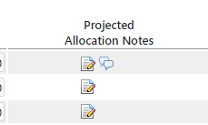
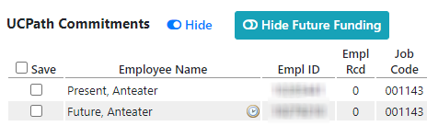
Other UI Improvements
Projection Notes Indicator
Future Funding Indicator

Slide 17
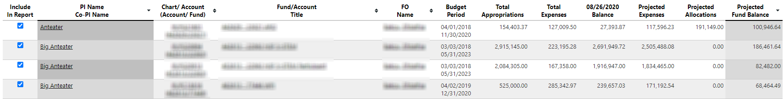
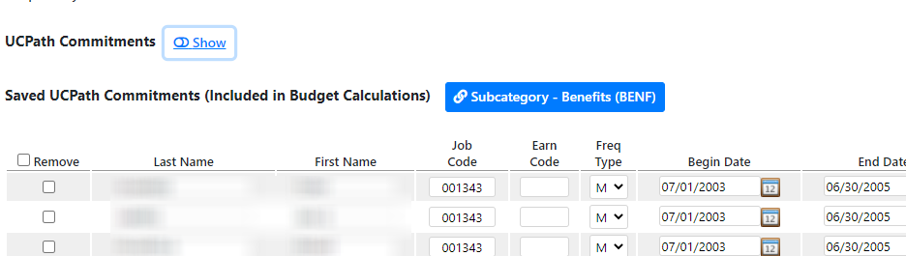
Other UI Improvements
Combination Sort (alt+click)
Show/Hide Commitments

Slide 18
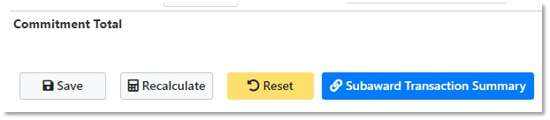
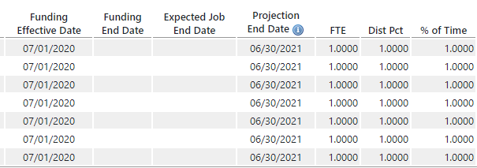
Other UI Improvements
Subaward Transaction Summary in GENX
Added better calculations for Projection End Dates

Slide 19
Thank You!
Thank you to all the testers who helped the past few months

